Slide 1
Integrity

Slide 2
What will you learn
Type Constraints
Attribute Constraint
Relvar Constraint
Database Constraint
The Golden Rule
State vs. Transition Constraints
Keys
Referential Integrity
Assertions
Triggers
Page <number>

Slide 3
1. Introduction
Integrity refers to the accuracy or correctness of data in the database.
the DBMS needs to be informed of such constraints, and of course needs to enforce them somehow.
e.g. Status values must be in the range 1 to 100
CONSTRAINT SC3 IS_EMPTY ( STATUS<1 OR STATUS>100);
Basically by rejecting any update that would otherwise violate them.
Page <number>

Slide 4
Introduction…
When a new constraint is declared, The system must first make sure the database currently satisfies it;
If not, the new constraint is rejected;
Otherwise it is accepted and enforced from that point forward.
DROP CONSTRAINT SC3;
We are concerned very specifically with declarative integrity support
declarative integrity support is important
  Relieve the burden
  More productive
Page <number>

Slide 5
Introduction…
A Constraint Classification Scheme:
Type constraint
Specifies the legal value for a given type.
Attribute constraint
Specifies the legal values for a given attribute.
Relvar constraint
Specifies the legal values for a given relvar.
Database constraint
Specifies the legal values for a given database.
Page <number>

Slide 6
2.Type Constraints
Type constraints are the most elementary form of integrity constraint. just a enumeration of the legal values of the type
e.g.
  CREATE DOMAIN COLOR# CHAR(6) DEFAULT ‘???’
  CONSTRAINT VALID_COLORS
  CHECK (VALUE IN (‘RED’, ‘ YELLOW’, ‘GREEN’, ‘???’));
  CREATE TABLE P(…,COLOR COLOR#,…);
A type constraints is a specification of the values that make up the type in question.
Type constraints are checked immediately.
No relvar can ever acquire a value of any attribute in any tuple that is not the appropriate type.
Page <number>

Slide 7
Type Constraints…
e.g. Use check clause to ensure that an hourly-wage domain allows only values greater than a specified value.
create domain hourly-wage numeric(5,2)
constraint value-test check(value > = 4.00)
  The domain hourly-wage is declared to be a decimal number with 5 digits, 2 of which are after the decimal point.
  The domain has a constraint that ensures that the hourly-wage is greater than 4.00.
  The clause constraint value-test is optional; useful to indicate which constraint an update violated.
Page <number>

Slide 8
Type Constraints…
/*先定义一个名为SexDomain的域*/
CREATE DOMAIN SexDomain CHAR(1)
CHECK (VALUE IN ('F' ,'M'))；
/*再用ALTER TABLE语句修改Customer表*/
ALTER TABLE Customer
ADD Contact_Psex SexDomain；
Page <number>

Slide 9
3.Attribute constraint
An attribute constraint is basically just a declaration to the effect that a specified attribute is of a specified type.
e.g.
  create table account
  (branch-name char(15),
  account-number char(10) not null,
  balance integer,
  ……)
Page <number>

Slide 10
Attribute constraint…
Attribute constraints are part of the definition of the attribute.
Attribute constraints are always checked immediately.
Any attempt to introduce an attribute value into the database that is not a value of the relevant type will simply rejected.
Page <number>

Slide 11
Attribute constraint…
CREATE TABLE Order
(Ono CHAR(4),
Cno CHAR(4) NOT NULL,
Odate DATE,
Freight INT CHECK (Freight BETWEEN 0 AND 1000),
…)；
Page <number>

Slide 12
4.Relvar Constraints
A relvar constraint is a constraint on an individual relvar.
e.g. suppliers in London must have status 20
  CONSTRAINT SC5
    IS_EMPTY (CITY=‘LONDON’ AND STATUS!=20);
Relvar constraints are always checked immediately.
Any statement that attempts to assign a value to a given relvar that violates any relvar constraint for that relvar will effectively just be rejected.
Page <number>

Slide 13
Relvar Constraints-SQL
CREATE TABLE Ewage
(Eno CHAR(1), /*职工号*/
Salary INT, /*基本工资*/
Allowance INT, /*津贴*/
Bonus INT, /*奖金*/
PRIMARY KEY(Eno),
CHECK (Bonus>0 AND Bonus<3*Salary)
/*奖金不得高于基本工资的３倍*/
)；
Page <number>

Slide 14
5.Database Constraints
A database constraint is a constraint that interrelates two or more distinct relvars.
e.g. no supplier with status less than 20 can supply any part in a quantity greater than 500.
  CONSTRAINT DBC1
    IS_EMPTY ( ( S JOIN SP )
    WHERE STATUS<20 AND QTY>500);
In general database constraint checking must be deferred to end-of-transaction.
If a database constraint is violated at COMMIT time, the transaction is rolled back.
Page <number>

Slide 15
6.The Golden Rule(黄金法则)
Any given relation has an associated predicate(谓词). A relvar too has a predicate.
Which serves as the criterion for acceptability of updates on the relvar
Ideally, the DBMS would know and understand the predicate for every relvar, but this goal is unachievable. The system does not know and understand predicate 100 percent. But, it does know a good approximation to that predicate. It knows the integrity constraints that apply to suppliers.
We define the relvar predicate for the supplier relvar to be the logical AND of all relvar constraints that apply to that relvar.
Page <number>

Slide 16
The Golden Rule…
e.g.
(IS_EMPTY(S WHERE STATUS<1 OR STATUS>100) AND
(IS_EMPTY(S WHERE CITY=‘London’ AND STATUS ≠20)) AND
(COUNT(S)=COUNT(S(S#)))
informal (external) predicate⬄ formal (internal)
Page <number>

Slide 17
The Golden Rule…
The Golden rule:
No update operation must ever be allowed to leave any relvar in a state that violate its own predicate.
No update transaction must ever be allowed to leave database in a state that violate its own predicate.
The golden rule applies to all relvars.
Page <number>

Slide 18
7. State vs. Transition Constraints
(静态和动态约束)
All of the constraints discussed in this chapter so far have been state constraints.
State constraints:
Concerned with correct states of the database.
Transition constraints :
on legal transitions from one correct state to another.
Page <number>

Slide 19
State vs. Transition Constraints…
The following transitions are all valid:
  Never married to married
  Married to widowed
  Married to divorced
  Widowed to married
The following transitions are not valid:
  Never married to widowed
  Never married to divorced
  Widowed to divorced
  Divorced to widowed
Page <number>

Slide 20

State vs. Transition Constraints…
e.g. No supplier's status must ever decrease.
S' – old value
TRC1 is a relvar transition constraint.
TRC1 applies to just a single relvar (suppliers)
TRC1 is checked immediately.
Page <number>

Slide 21
8. Keys
Candidate Keys and superkey
Primary Keys and Alternate Keys
Foreign Keys
Page <number>

Slide 22
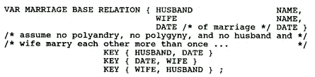
Candidate Keys
Let K be a set of attributes of relvar R. Then K is a candidate key for R if and only if it possesses both of the following properties:
  Uniqueness: No legal value of R ever contains two distinct tuples with the same value for K.
  Irreducibility(不可约的): No proper subset of K has the uniqueness property.
Page <number>

Slide 23

Candidate Keys…
Every relvar does have at least one candidate key
A candidate key definition is really just shorthand for a certain relvar constraint. Useful for provide the basic tuple –level addressing mechanism in the relational model
A superset of a candidate key is a superkey. For example, the set of attributes {S#,CITY} is a superkey for relvar S.
Page <number>

Slide 24
Primary Keys and Alternate Keys
It is possible for a given relvar to have more than one candidate key. One of those keys be chosen as the primary key, and the others are then called alternate keys.
e.g.
  create table customer
  (customer-name char(20) not null,
  customer-street char(30),
  customer-city char(30),
  primary key (customer-name));
  create table branch
  (branch-name char(15) not null,
  branch-city char(30),
  assets integer,
  primary key (branch-name));
Page <number>

Slide 25
Foreign Keys
Let R2 be a relvar. Then a foreign key in R2 is a set of attributes of R2, say FK, such that:
  There exists a relvar R1 (R1 and R2 not necessarily distinct) with a candidate key CK, and
  For all time, each value of FK in the current value of R2 is identical to the value of CK in some tuple in the current value of R1.
Every value of a given foreign key to appear as a value of the matching candidate key. The converse is not a requirement.
A foreign key is simple or composite according as the candidate key it matches
Terms: reference; referenced tuple; referential integrity problem; referential constraint; referencing relvar, referenced relvar
Page <number>

Slide 26
Referential Integrity in SQL – Example
create table account
(branch-name char(15),
account-number char(10) not null,
balance integer,
primary key (account-number),
foreign key (branch-name) references branch);
create table depositor
(customer-name char(20) not null,
account-number char(10) not null,
primary key (customer-name, account-number),
foreign key (account-number) references account,
foreign key (customer-name) references customer);
Page <number>
Notes:
外键可以做成属性约束，主键不行
现在是relva约束

Slide 27
9. Referential Actions
DELETE/UPDATE rule for a particular foreign key:
  CASCADE
  RESTRICT（NO ACTION)
  SET NULL
  SET DEFAULT
Page <number>
Notes:
restrict(约束):当在父表（即外键的来源表）中删除对应记录时，首先检查该记录是否有对应外键，如果有则不允许删除。
no action:意思同restrict.即如果存在从数据，不允许删除主数据。
cascade(级联):当在父表（即外键的来源表）中删除对应记录时，首先检查该记录是否有对应外键，如果有则也删除外键在子表（即包含外键的表）中的记录。
set null:当在父表（即外键的来源表）中删除对应记录时，首先检查该记录是否有对应外键，如果有则设置子表中该外键值为null（不过这就要求该外键允许取null）
注：NO ACTION和RESTRICT的区别：只有在及个别的情况下会导致区别，前者是在其他约束的动作之后执行，后者具有最高的优先权执行。
设置默认值 如果表的所有外键列均已定义默认值，则将该值设置为列定义的默认值。仅适用于 SQL Server 2005。

Slide 28
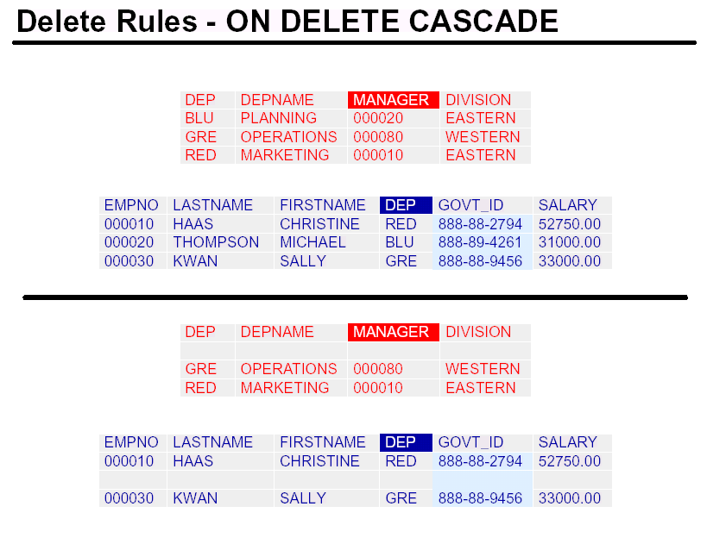
Page <number>
Notes:
级联 前表动了后表不会动 部门动了，后面跟着更新

Slide 29
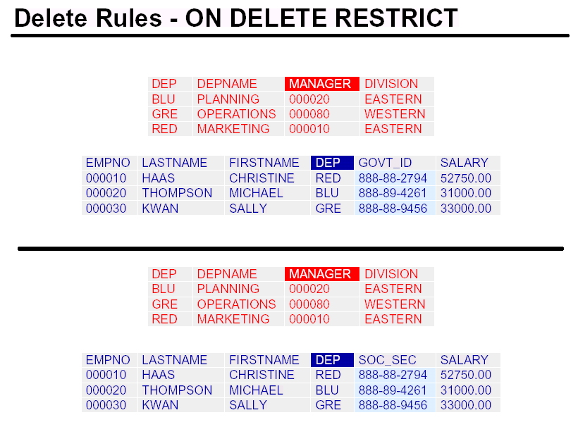
Page <number>
Notes:
限制 后表想动，前表有约束动不了 部门撤销了 但是部门都有人，撤销不了
前表置空/缺省值

Slide 30
Referential Actions
CREATE TABLE SP
(S# S# NOT NULL,
P# P# NOT NULL,
QTY QTY NOT NULL,
PRIMARY KEY(S#,P#),
FOREIGN KEY (S#) REFERENCE S
ON DELETE CASCADE
ON UPDATE CASCADE
FOREIGN KEY (P#) REFERENCE P
ON DELETE CASCADE
ON UPDATE CASCADE
CHECK(QTY>0 AND QTY<5001));
Page <number>

Slide 31
Referential Actions…
create table account
(. . .
foreign key(branch-name) references branch
on delete cascade
on update cascade.
. . . )
Due to the on delete cascade clauses, if a delete of a tuple in branch results in referential-integrity constraint violation, the delete “cascades” to the account relation, deleting the tuple that refers to the branch that was deleted.
Cascading updates are similar.
Page <number>
Notes:
级联要么不删，要么一起都删了

Slide 32
Referential Actions…
If there is a chain of foreign-key dependencies across multiple relations, with on delete cascade specified for each dependency, a deletion or update at one end of the chain can propagate across the entire chain.
If a cascading update or delete causes a constraint violation that cannot be handled by a further cascading operation, the system aborts the transaction. As a result, all the changes caused by the transaction and its cascading actions are undone.
Page <number>

Slide 33
10. Triggers
A trigger (触发器) is a statement that is executed automatically by the system as a side effect of a modification to the database.
To design a trigger mechanism, we must:
  Specify the conditions under which the trigger is to be executed.
  Specify the actions to be taken when the trigger executes.
The SQL standard does not include trigger, but many implementations support triggers.
Page <number>
Notes:
一般在增删改的时候做触发器，查看不用
触发条件/触发行为
标准SQL没有触发器

Slide 34
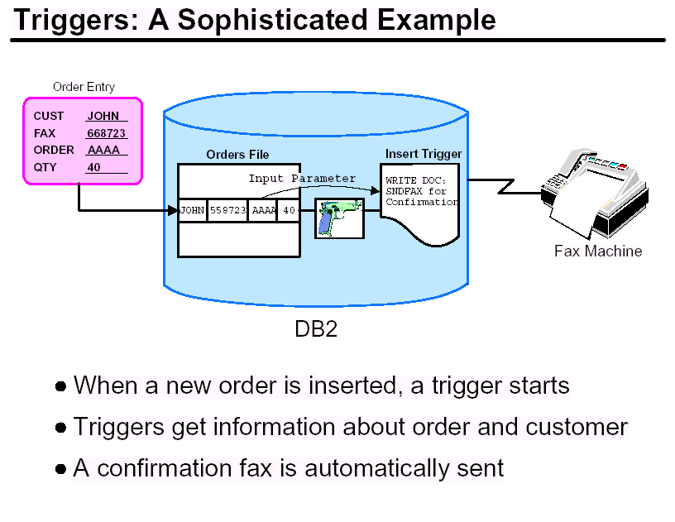
Page <number>

Slide 35
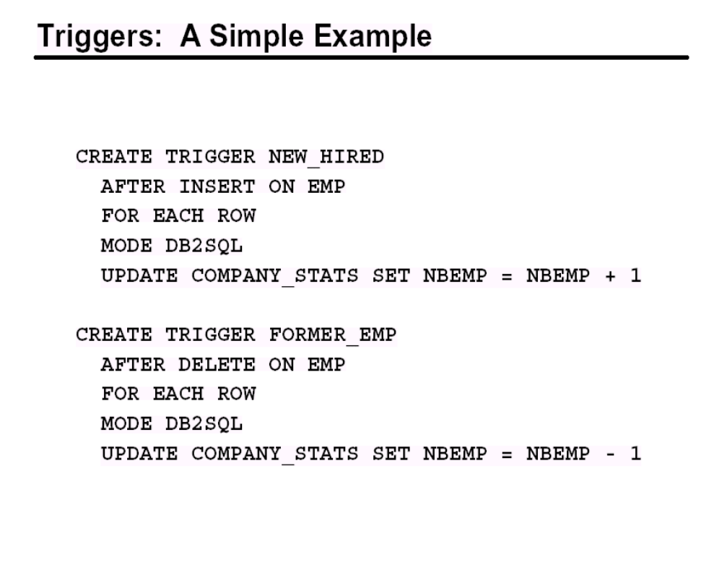
Page <number>
Notes:
mode db2sql; -- 修改自定义结构数据类型

Slide 36
Triggers-Example
Suppose that instead of allowing negative account balances, the bank deals with overdrafts by
  setting the account balance to zero
  creating a loan in the amount of the overdraft
  giving this loan a loan number identical to the account number of the overdrawn account
The condition for executing the trigger is an update to the account relation that results in a negative balance value.
Page <number>

Slide 37
Triggers-Example…
define trigger overdraft on update of account T
(if new T.balance < 0
then (insert into loan values
(T.branch-name, T.account-number, –newT.balance)
insert into borrower
(select customer-name, account-number
from depositor
where T.account-number = depositor.account-number)
update account.S
set S.balance = 0
where S.account-number = T.Account-number))
The keyword new used before T.balance indicates that the value of T.balance after the update should be used; if it is omitted, the value before the update is used.
Page <number>
Notes:
银行处理透支

Slide 38
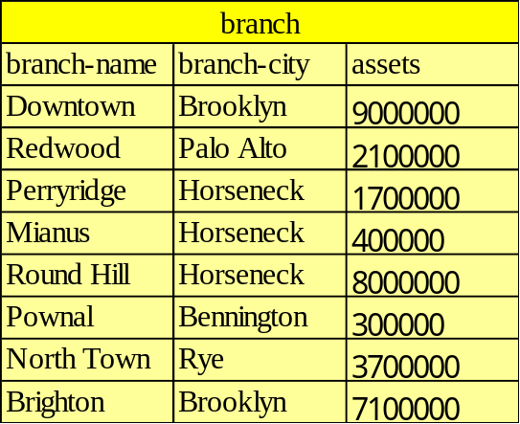
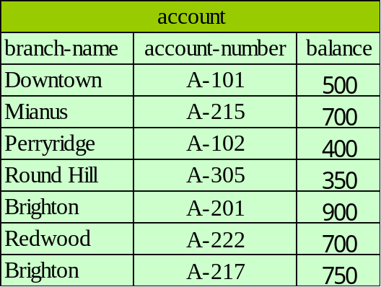
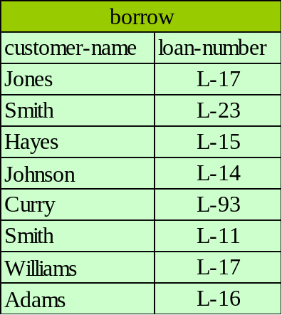
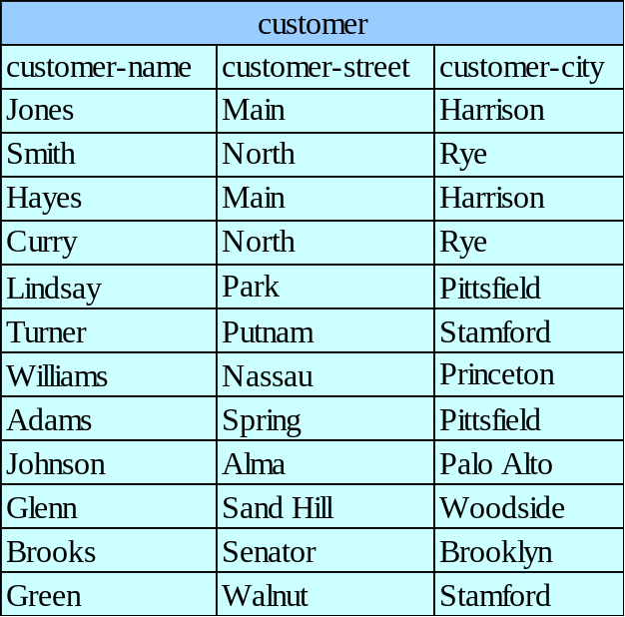
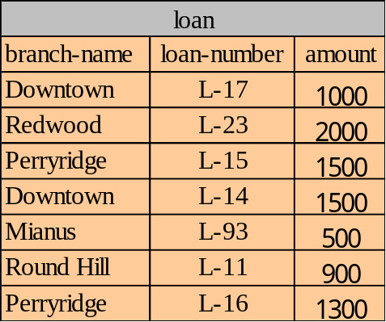
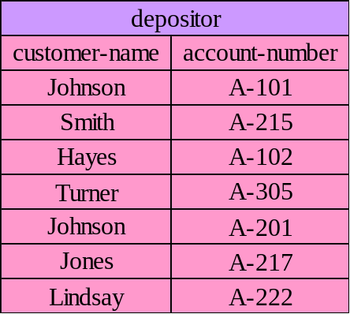
Banking Example
Page <number>

Slide 39
11. Assertions
An assertion (断言) is a predicate expressing a condition that we wish the database always to satisfy.
An assertion in SQL takes the form
create assertion <assertion-name> check <predicate>
When an assertion is made, the system tests it for validity. This testing may introduce a significant amount of overhead; hence assertions should be used with great care.
Page <number>
Notes:
有一定代价，涉及两个以上的表，在表定义中加不上

Slide 40
Assertions
Create assertion IC11 check
((select min(S.status) from S ) >4);
Create assertion IC18 check
(not exist ( select * from P
Where not (P.weight>0)));
Page <number>

Slide 41
Assertions…
ALTER TABLE Customer
ADD Discount_Flag CHAR(1) CHECK (VALUE IN('Y', 'N'))；
CREATE ASSERTION DiscountCustomer CHECK
(NOT EXISTS
(SELECT *
FROM Customer Cx
WHERE Cx.Discount_Flag="Y" AND
(20>=
(SELECT COUNT(*)
FROM Order Ox
WHERE Ox.Cno=Cx.Cno ) ))；
在Customer表中增加一个属性列Discount_Flag，其值可以是“Y”和“N”之一，“Y”表明该客户在订货时可以享受折扣率为5%的优惠，“N”正好相反。并规定可以享受优惠价的客户至少必须已经发过20张订单。
Page <number>
Notes:
在customer表中增加一个属性列Discount Flag，值可以是Y N之一， Y表示订货享受5%优惠，N正好相反，并规定可以享受优惠价的客户必须发货20张订单
动态约束等一些约束在开始的时候做不了

Slide 42
Assertions…
例．定义一个广州客户的订单表Order_GZ(Ono，Cno，Odate，Freight)，在该基本表被定义以后，可以用如下的断言来保证存放在Order_GZ中的客户Cno总是位于广州的客户。
CREATE ASSERTION Cno_GZ CHECK
(NOT EXISTS
(SELECT *
FROM Customer,Order_GZ
WHERE Customer.Cno=Order_GZ.Cno AND
Customer.City<>"广州"
)
)；
CREATE TABLE Order_GZ(…
CONSTRAINT CS1 CHECK（Cno IN（SELECT Cno FROM
Customer WHERE City=“广州”））…);
Page <number>
Notes:
保证居住地一定是广州

Slide 43
Assertions…
Dropping an assertion in SQL takes the form
DROP assertion <assertion-name>
Does not offer a restrict vs cascade option.
In SQL, constraints can be defined to be Deferrable / not deferrable
not deferrable -→ always check immediately
Deferrable-→ can be switched on and off by
Set constraints IC46,IC95 deferred
Set constraints IC46,IC95 immediate
COMMIT forces a “set * immediate” for all deferrable constraints
Page <number>

Slide 44
SQL facilities
SQL classifies constraints into three broad categories,as follows:
Domain constraints
Base table constraints
General constraints (assertion)
SQL has no support at all or transition constraints, nor does it support triggered procedure
Page <number>

Slide 45
Practical
指出上次作业描述的关系模型中各关系模式的主码、候选码、外部码
分析在上次作业描述的关系模型中，存在哪些完整性要求；
分析在你的关系模型中，需要定义那些用户视图？并说明其作用；
对所定义的视图，更新时有无限制，并举例说明。
使用SQL定义该关系模型（包括用户视图）；
在DB定义中，主码、外部码、引用完整性、用户完整性等是如何体现的；
在你的数据库中，有哪些常见的查询操作？分别用关系代数和SQL语言实现之；
Page <number>

